Slide 1
Algebra
just another language

Slide 2
aim: what is the connection between functions in algebra and functions in Racket
warm up:
Take a laptop and a worksheet back to your seat
Notes:
Think back to the first blocks pattern.
What was the input of the function? (stage)
What was the output? (# of blocks)
y = x + 1
what is the input, what is the output

Slide 3
in Racket we define values this way:
we can even define values in terms of what has come before
(define x 4)
(define y (+ x 10))

Slide 4
in algebra we define values using an equal sign
algebra
racket
and we can define values in terms of other values
x = 4
(define x 4)
y = x + 10
(define y (+ x 10))

Slide 5
on your hand-out: convert the code into algebra
Racket Code | Algebra
(define x 10) | x = 10
(define y (* x 2)) | y = x*2 or y=2x
(define z (+ x y))
(define age 14)
(define months (* age 12))
(define days (* months 30))
(define hours (* days 24))
(define minutes (* hours 60))

Slide 6
you also know how to define functions like this one
what is the name of this function?
(define (f x) (+ x 1))
How many variables does it take?
What is the name of that variable?
What does the function do to the variable x?
Notes:
tell me the name of this function?
How many variables does it take? What is the name of that variable?
What does the function do to the variable x?
Can you define a function g, which takes in a variable q and multiplies it by 20.

Slide 7
can you define a function g, which takes in a variable q and multiplies it by 20?
can you define a function h, which takes in a variable r and divides it by 2 then adds 5?
can you define a function f, which takes in a variable s and multiplies it by 1/3?
can you define a function g, which takes in a variable t and subtracts 13 from it?

Slide 8
now translate them into algebra

Slide 9


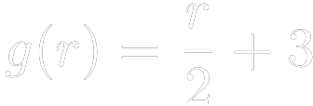

can you translate this algebra into code?
1)
2)
3)
4)

Slide 10
Today we are going to look at some word problems that you will see in algebra

Slide 11
Warm Up
No computers today.
Take a warm up slip and answer the six questions.

Slide 12
Describe how the function + works.

Slide 13

Review:
by replacing define with an equal sign
we can write
this is called functions notation.
it says the function "f of x" equals "x + 1"

Slide 14
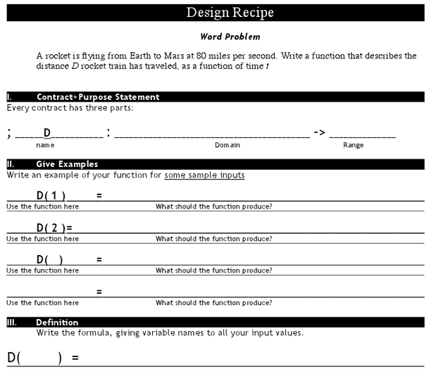
Distance

Slide 15
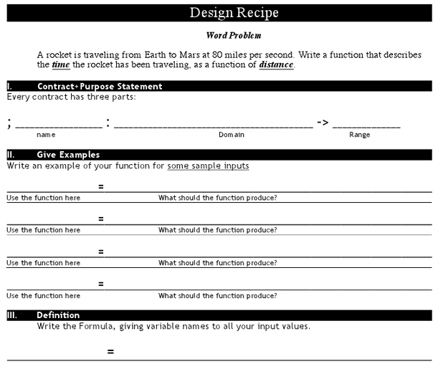

Slide 16
Suppose we had a word problem that wanted to know how far the rocket traveled in 6 seconds: which one would we use?
What if we wanted to know how long it takes for the rocket to go a thousand miles?
What if I knew the train left at 1pm, and I wanted to know what time it arrives in Chicago, 800 miles away?
Would I want my time function, or my distance function?

